Slide 1

VIRTUAL FIGHT (A game in C++)
By: Tushar Gupta
Roll no- 1900320100184
Department of : Computer Science and Engineering (Sec: C)

Slide 2
Introduction
In modern time computer games are getting widely spread throughout the world.
They are a good way of relieving stress.
So, in my project I was able to delve into the creation process of them through C++ language
I have created a fighting game with all essential that could make the game fun and playable. let me take you to the tour of my project…..

Slide 3
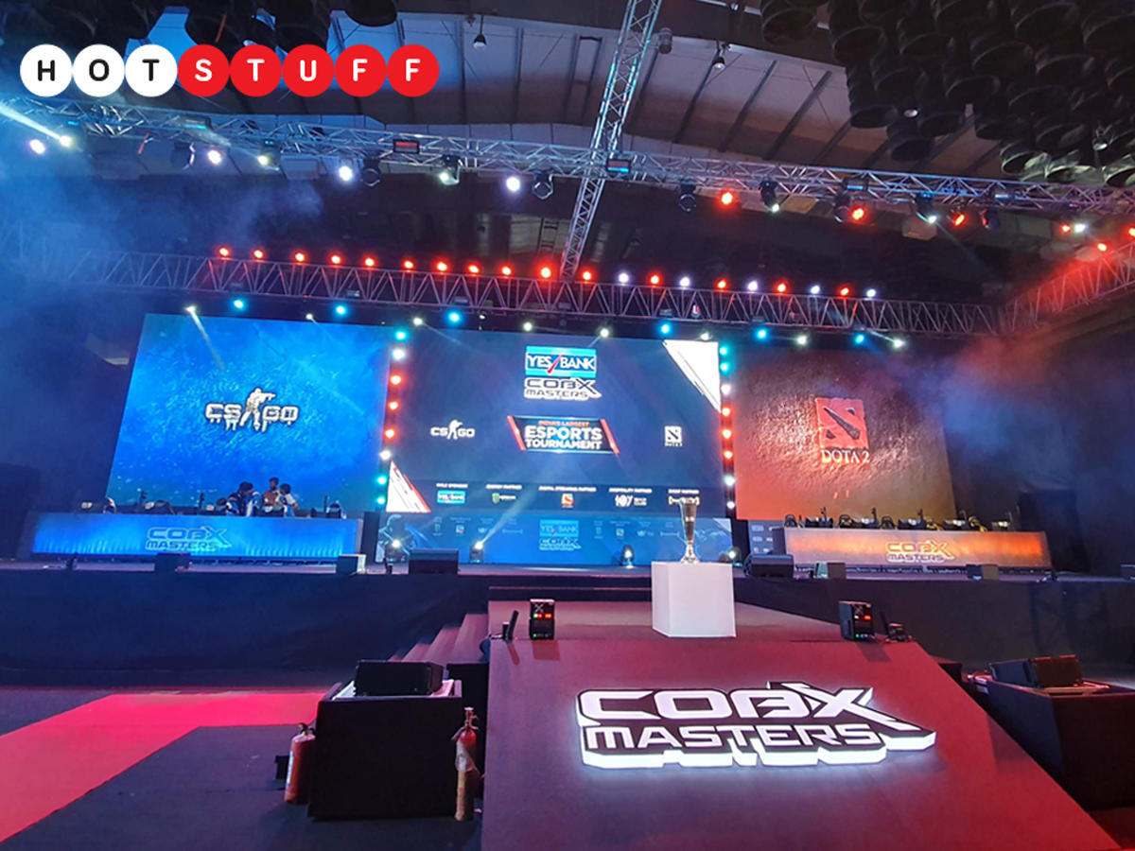
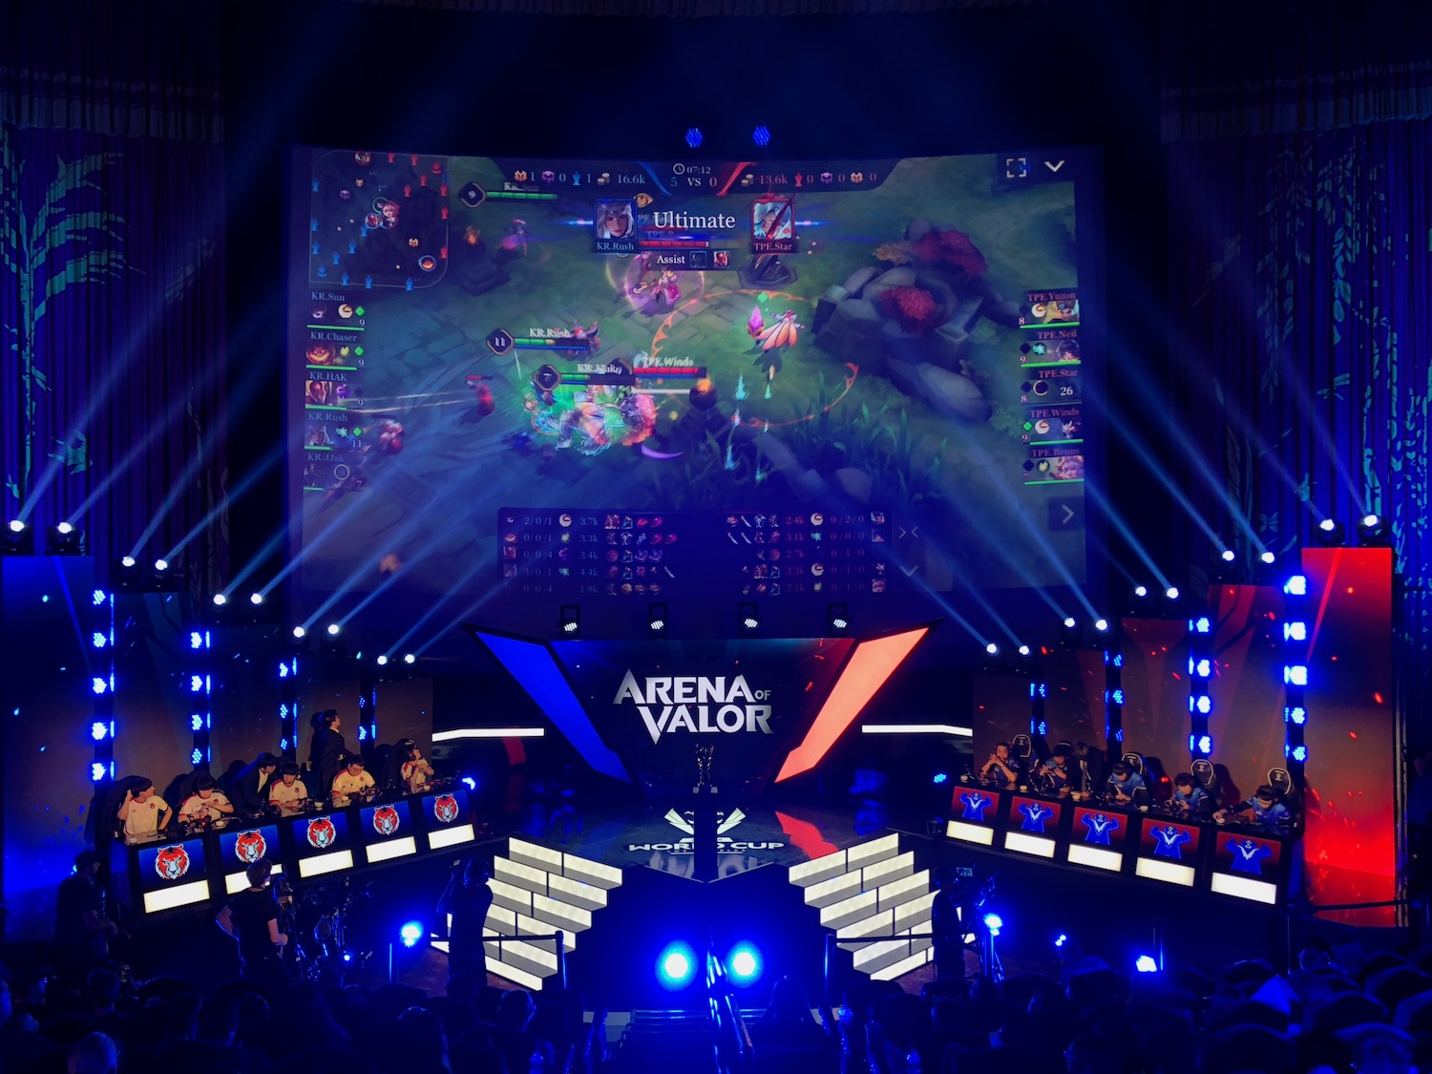
Gaming now an e-sports
Computer (video) games are now a days emerging as a sport in the form of E-sports where players throughout the world compete in a particular game in tournaments to win the prize of the best. Some of these are…
- Arena of Valor World Cup
- COBX Masters (held In India)

Slide 4
new header files used
Graphic.h- it is used to create graphics in Bgi graphic window for dos-box
Windows.h- I have used this header file for one of its function: getasynckeystate (key to be checked);
This function tells me weather the specified key is pressed or not

Slide 5
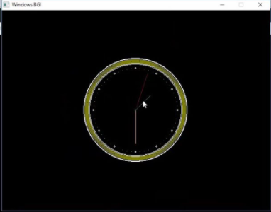
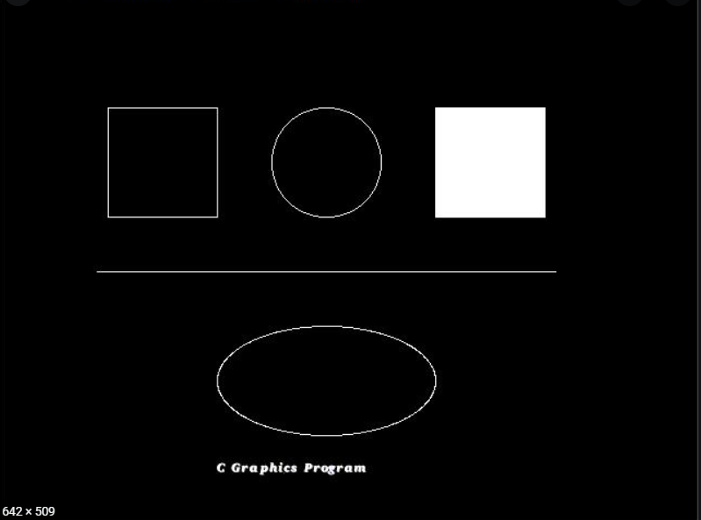
Graphic.h
This header file includes various functions to work with graphic, but the most important functions are initgraph( int, int, string ); or
initwindow( int, int, header, int, int);
[*blue parameters can be ignored]
these header file opens the bgi window on which the graphics can me made.. (otherwise no output will be shown)

Slide 6
Additional user defined header files
These header files are created by me to use long code in form of functions by including them:-
Gamecode.h
Register.h

Slide 7
register.h
This header file contains functions-
Void Register (); //it intakes the info of user and uses file handling to store it in a file.
Void Login (); //it checks weather the user is already registered or not i.e he/she have its info in file or not

Slide 8
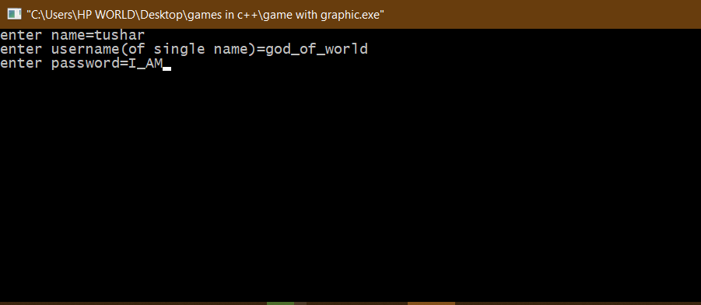
Register() output

Slide 9
GAMECODE.h
As the name suggests this header file contains only one function:-
int gamecode(); /*this function contains the whole code of my game which is called in the
main program for the game to start*/

Slide 10
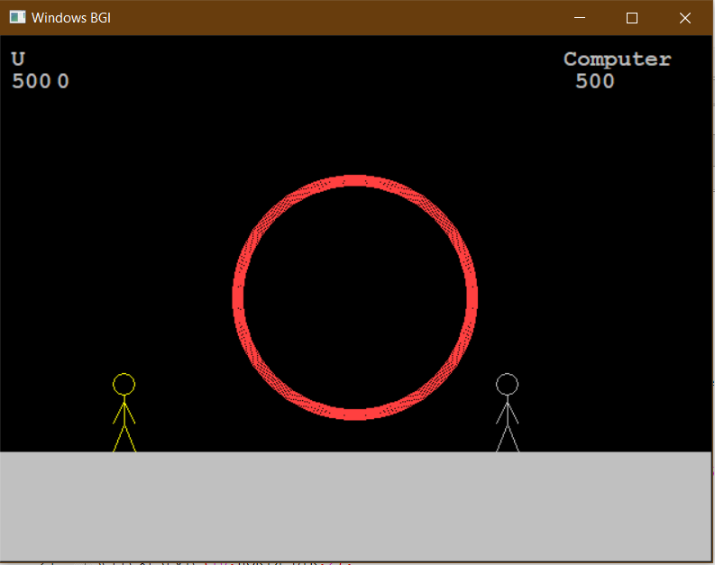
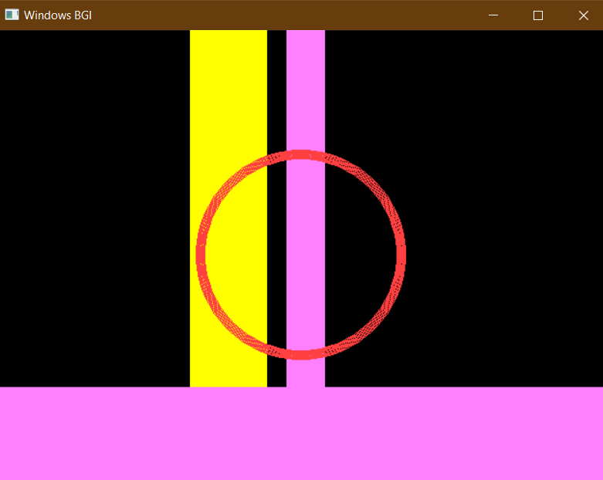
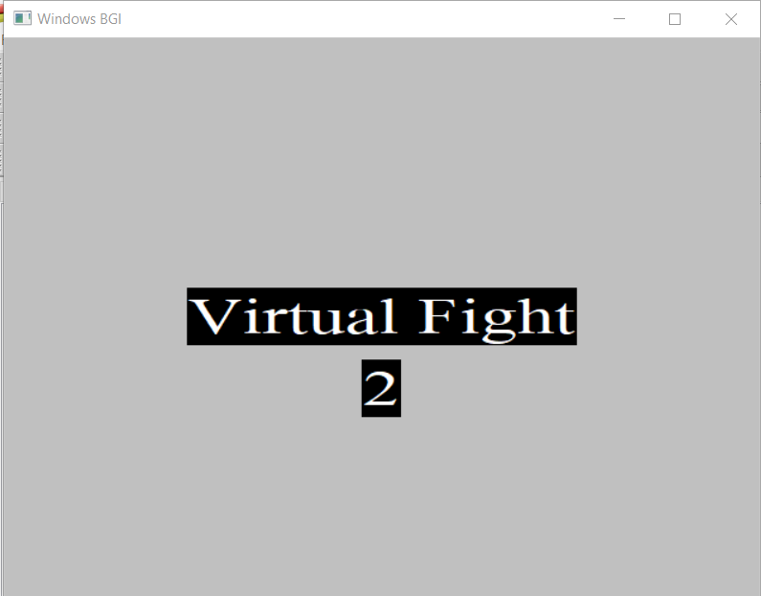
Gamcode() output

Slide 11
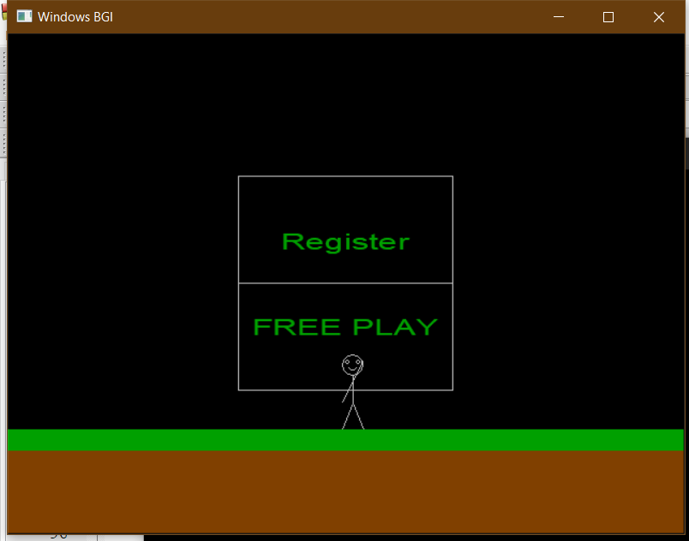
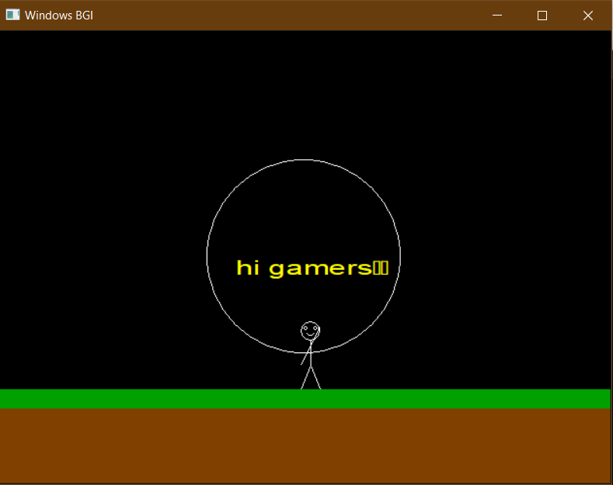
Project outputs

Slide 12
Future Scope
Updates that I am planning are-
2 Player System (currently it only has 1 player option against computer): Vs-1.2 [currently in progress…]
Reaction system (get reactions upon being hit) : Vs-1.3
Background options (you will get option to choose the background from )
: Vs-1.5
New Types of games (after all above updates…): Vs-2.0

Slide 13
THANK YOU

